Slide 1
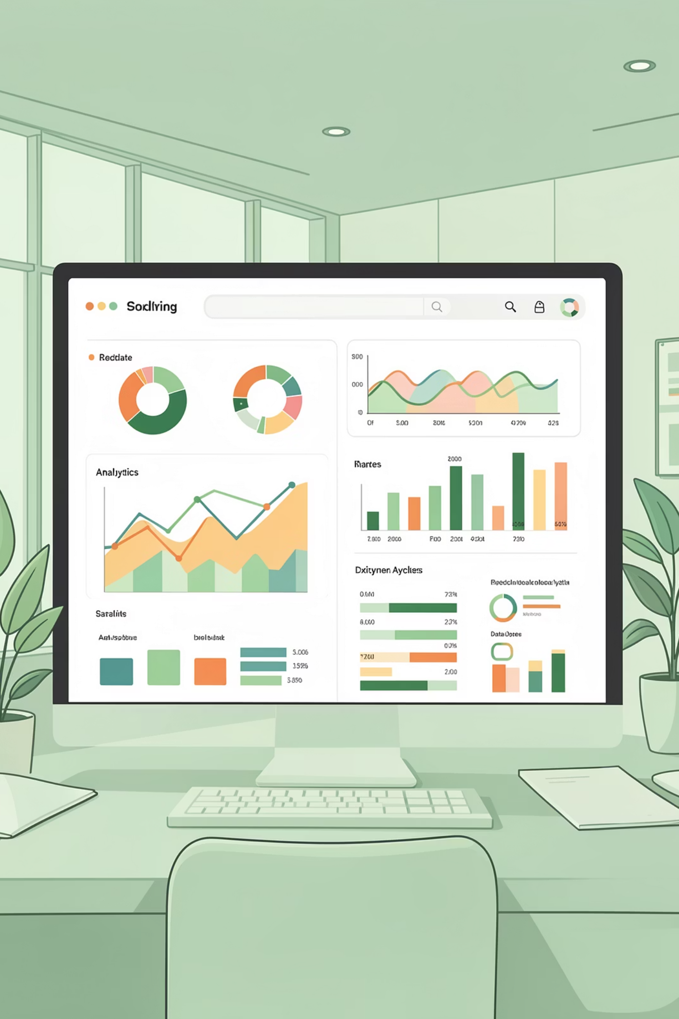
Customer Shopping Behavior Analysis
Uncovering insights from 3,900 purchases to drive strategic decisions

Slide 2

DATASET OVERVIEW
The Foundation
3.9K
18
Key Data Captured
Customer demographics & location
Purchase details & preferences
Shopping behavior patterns
Subscription & loyalty metrics
Total Purchases
Data Points
Transactions analyzed
Features per customer
4
Categories
Product segments

Slide 3
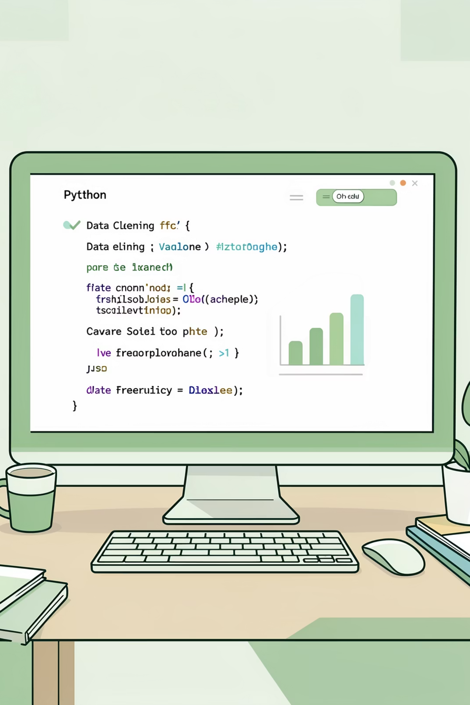
PYTHON ANALYSIS
Data Preparation Journey
01
Data Loading & Exploration
Imported dataset, checked structure and summary statistics
02
Cleaning & Standardization
Handled missing values, renamed columns to snake case
03
Feature Engineering
Created age groups and purchase frequency metrics
04
Database Integration
Connected to PostgreSQL for advanced analysis

Slide 4
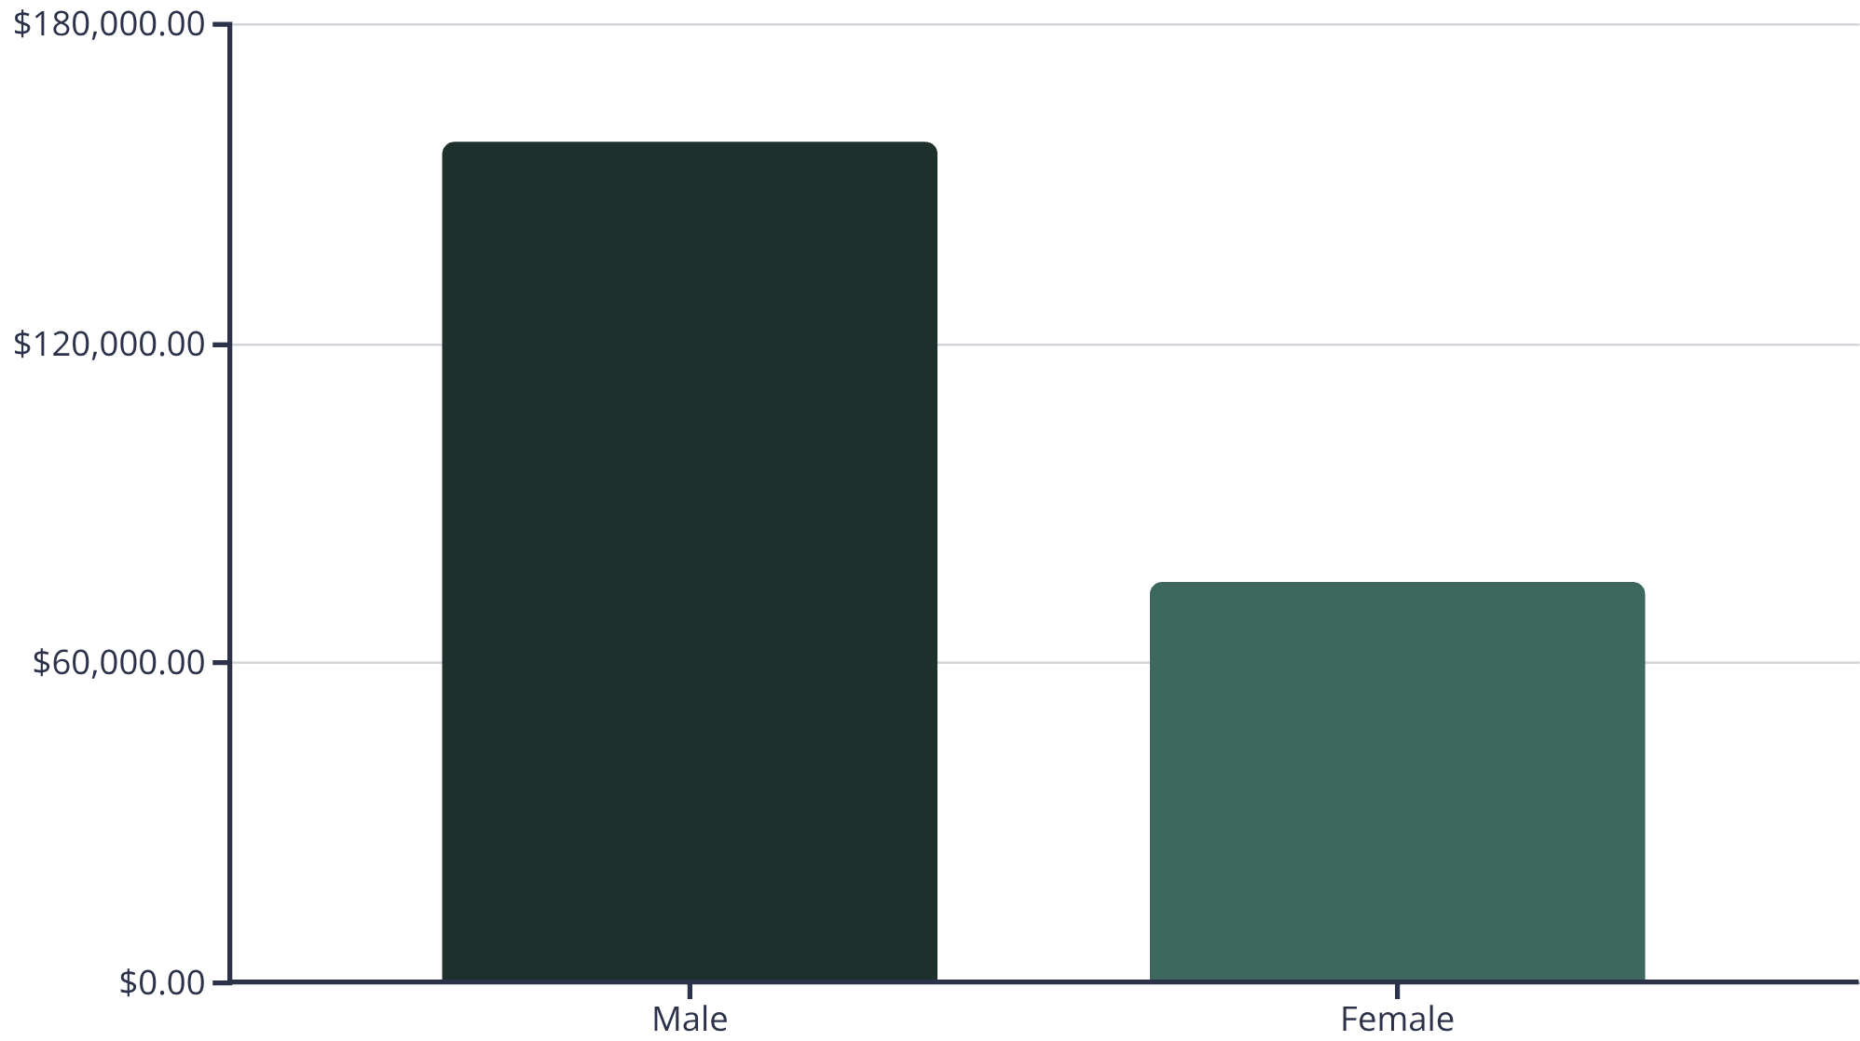
SQL INSIGHTS
Revenue Analysis
Gender Revenue Split
Male customers generate 68% of total revenue, significantly outpacing female customers.
This insight suggests targeted marketing opportunities for both segments.

Slide 5

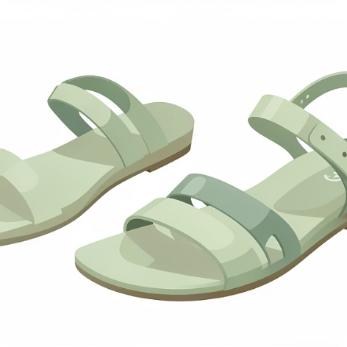



Top-Rated Products
Gloves
Sandals
Boots
Hat
Rating: 3.86
Rating: 3.84
Rating: 3.82
Rating: 3.80
Skirt
Rating: 3.78

Slide 6

Customer Segmentation
Loyal Customers
Returning Buyers
3,116 customers
701 customers
80% of customer base
18% of customer base
New Shoppers
83 customers
2% of customer base

Slide 7
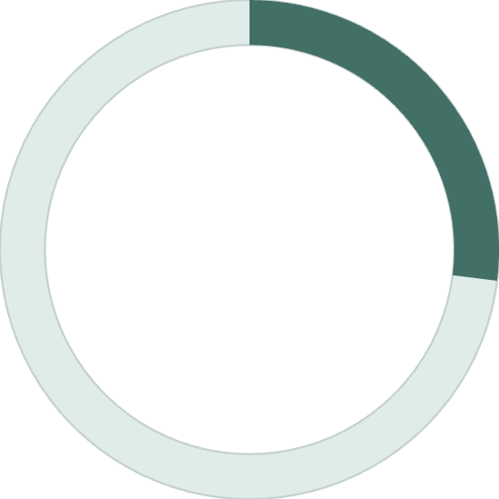
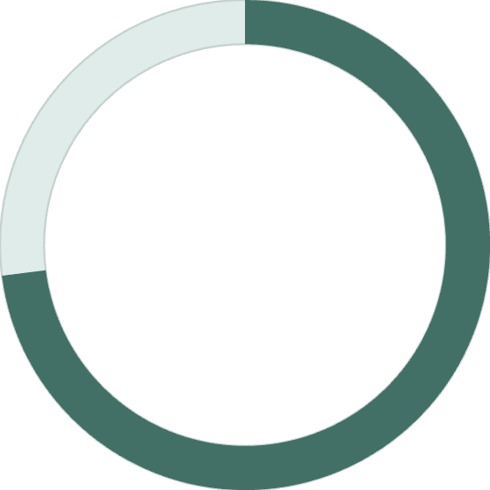
SUBSCRIPTION ANALYSIS
Subscription vs. Non-Subscription
Spending Patterns
Subscribers: $59.49 avg spend
Non-subscribers: $59.87 avg spend
27%
Minimal spending difference suggests subscription benefits need enhancement to drive value perception.
Subscribers
1,053 customers
73%
Non-Subscribers
2,847 customers

Slide 8
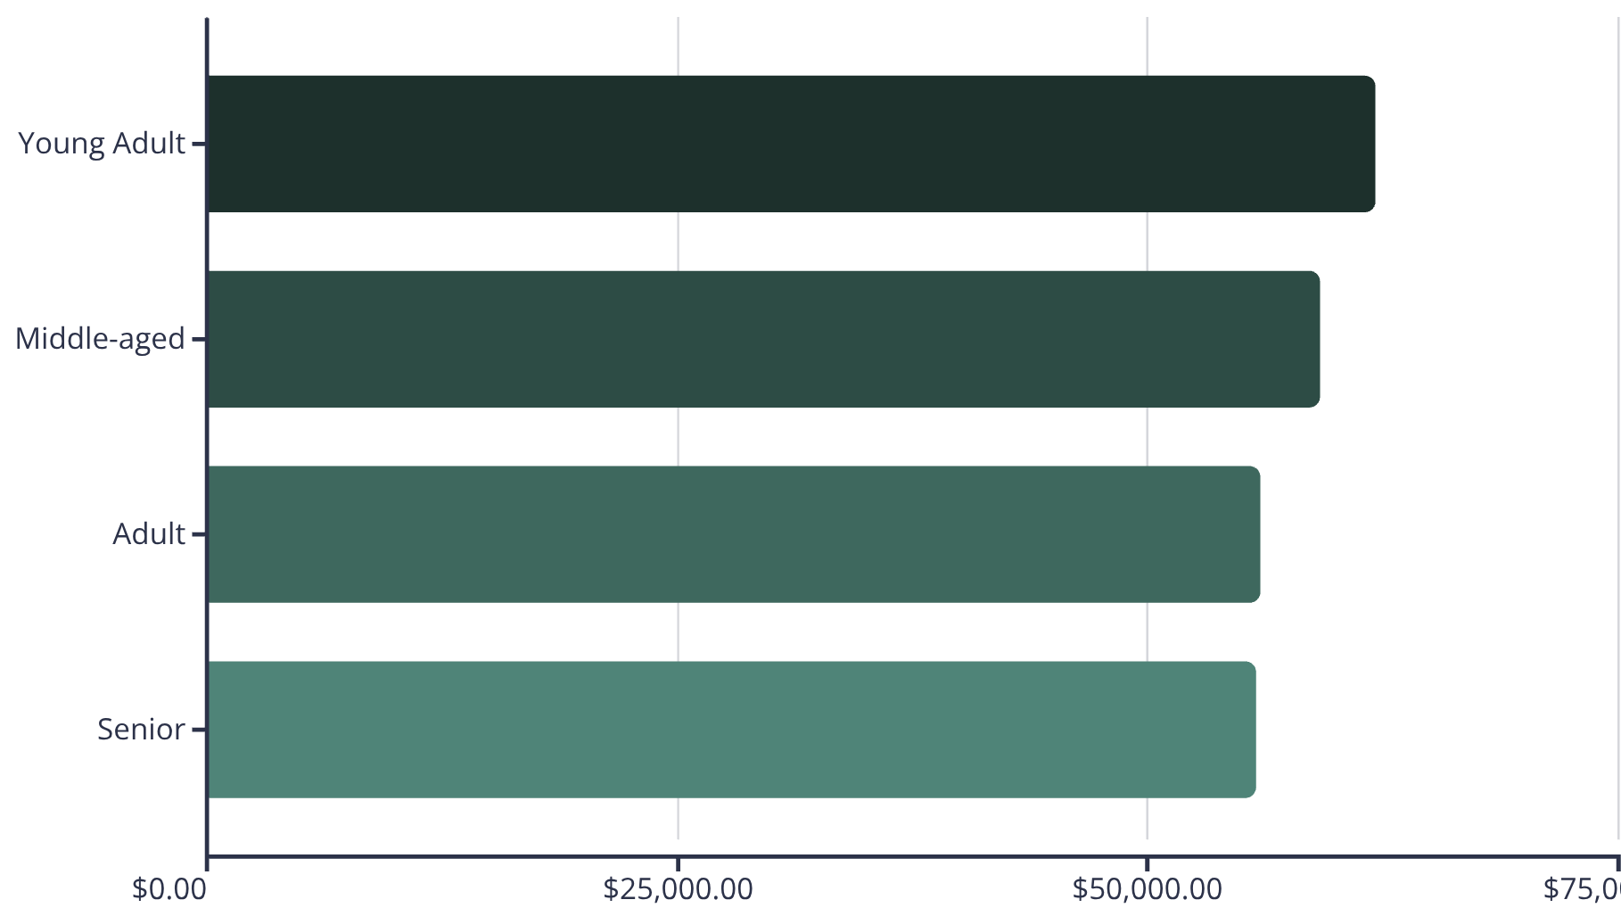
Revenue by Age Group
Key Insight
Young adults lead revenue generation, contributing 27% of total sales.
Relatively balanced distribution across age groups presents opportunities for targeted campaigns.

Slide 9
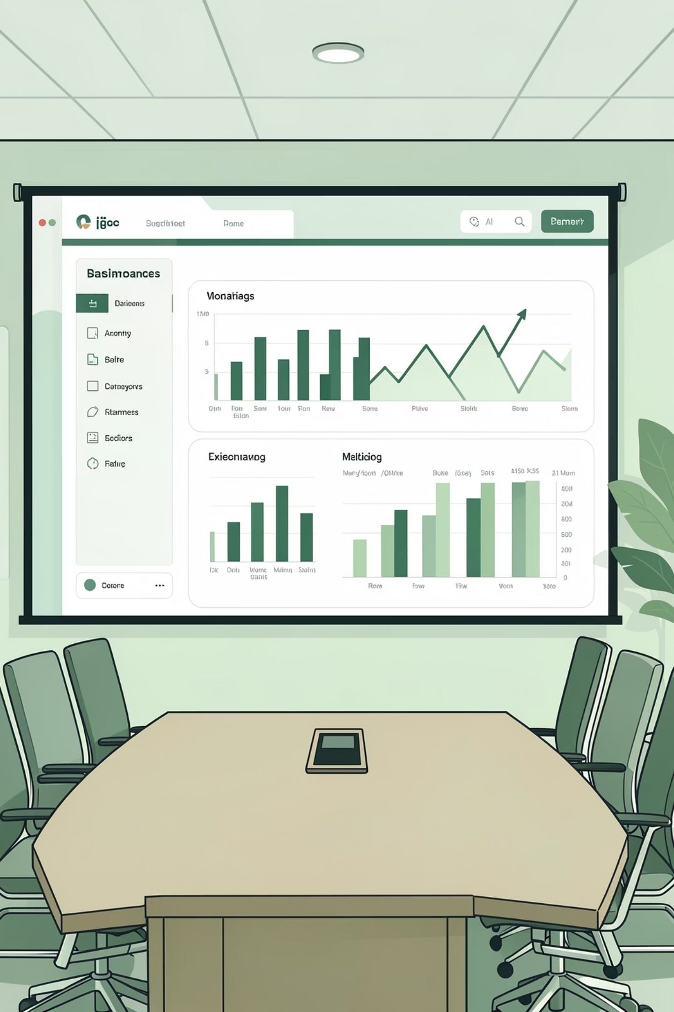
Power BI Dashboard
Interactive visualization bringing data to life
Real-Time Metrics
Category Performance
Customer Insights
Track KPIs instantly
Revenue & sales breakdown
Segmentation & behavior

Slide 10




RECOMMENDATIONS
Strategic Action Plan
Boost Subscriptions
Loyalty Programs
Promote exclusive benefits and perks
Reward repeat buyers
Targeted Marketing
Product Positioning
Focus on high-revenue segments
Highlight top-rated items

